Slide 1
Principle Component Analysis (PCA)
Simple regression
PLS regression
PLS-DA

Slide 2
PCA
Two major common effects of using PCA
Convert a group of correlated predictive variables to a group of independent variables
Construct a “strong” predictive variable from several “weaker” predictive variables
A
(n x p)
PC
(n x p)
A = data matrix
PC = principal component matrix
n = # of observations
p = # of variables

Slide 3

A number of following slides of this presentation have been collected from internet. The original slides were prepared by the following persons:

Slide 4
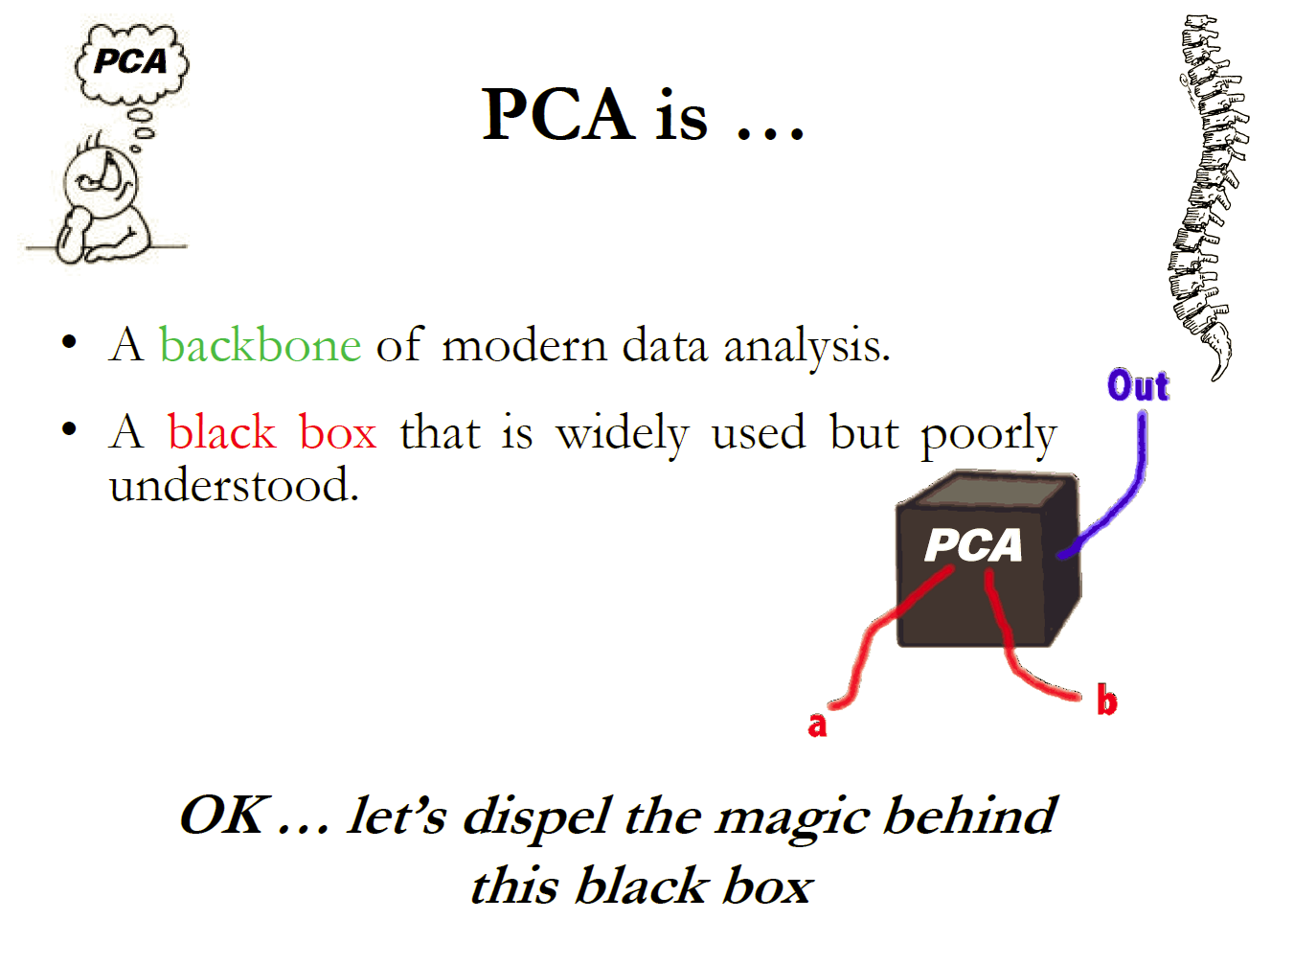

Slide 5
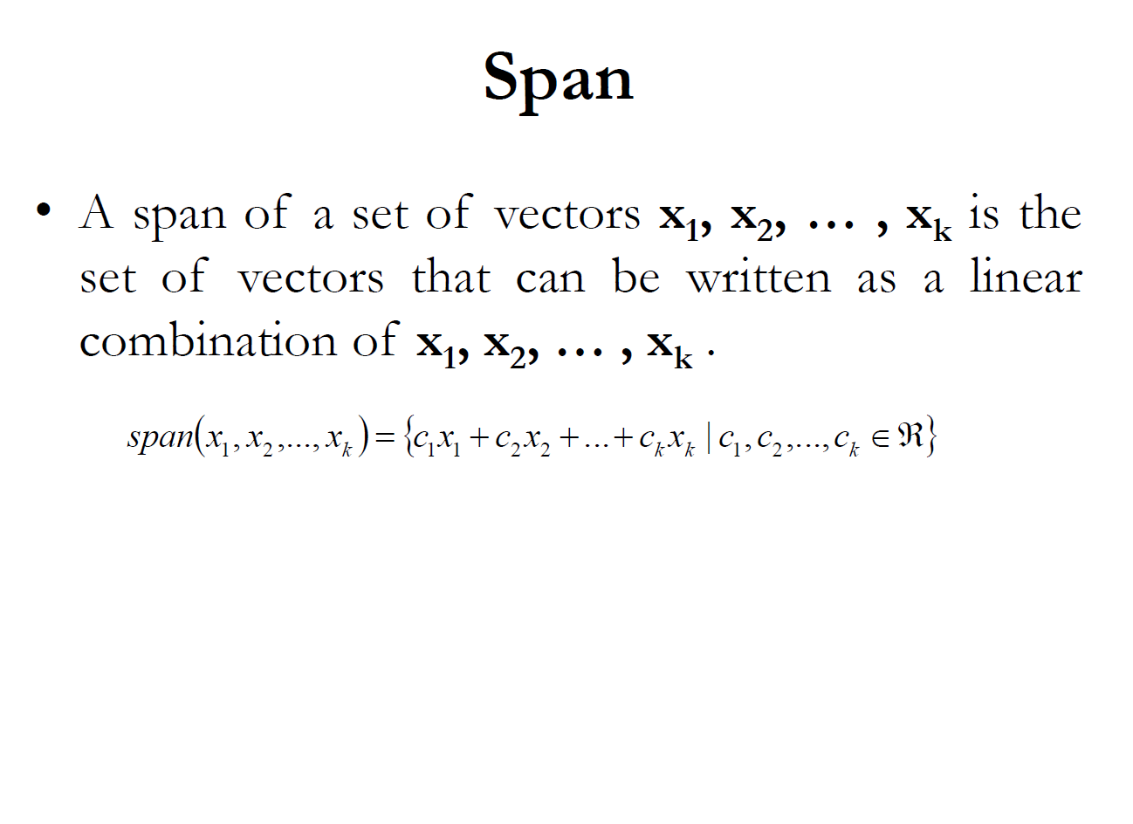

Slide 6
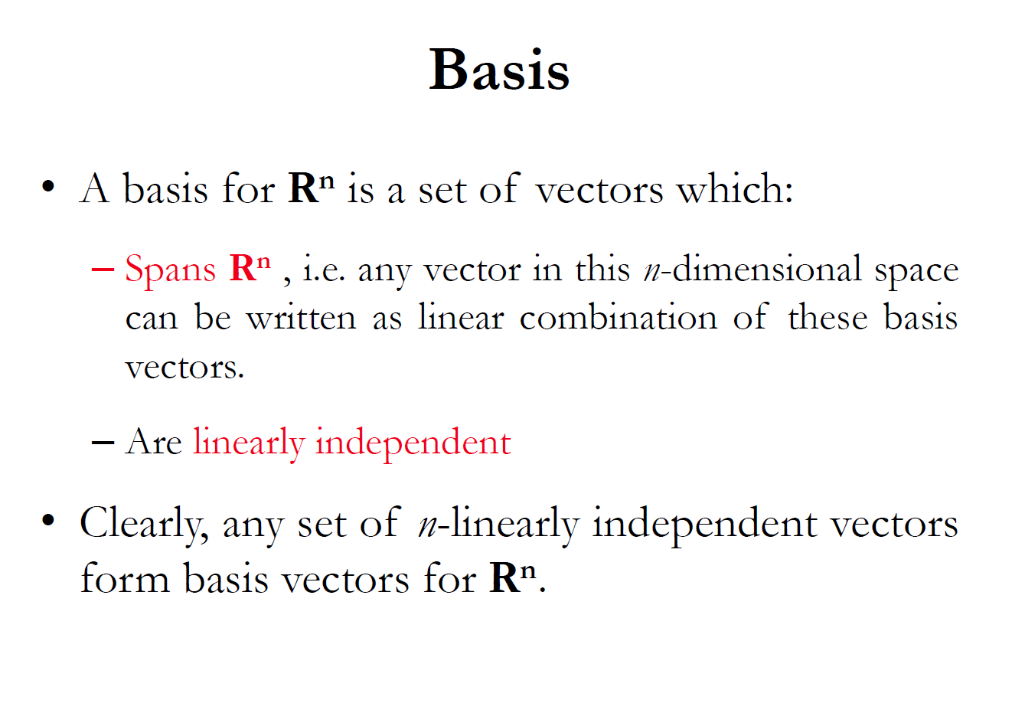

Slide 7
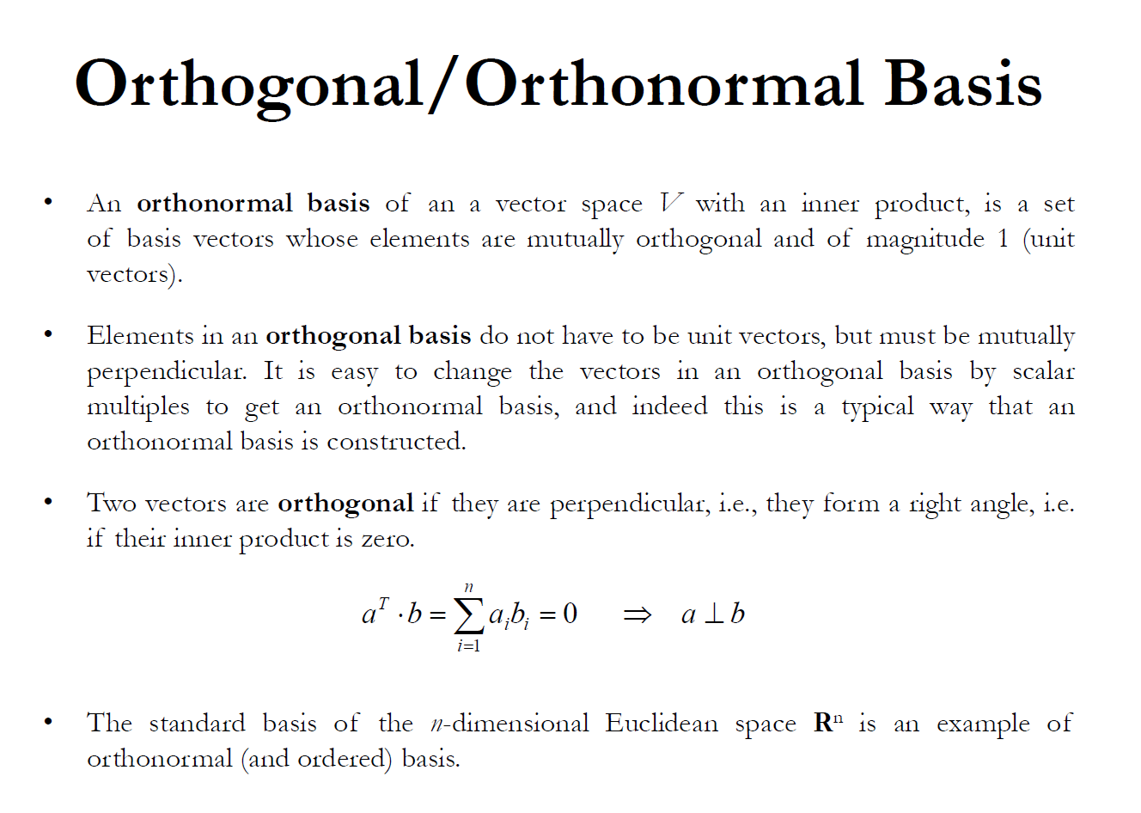

Slide 8
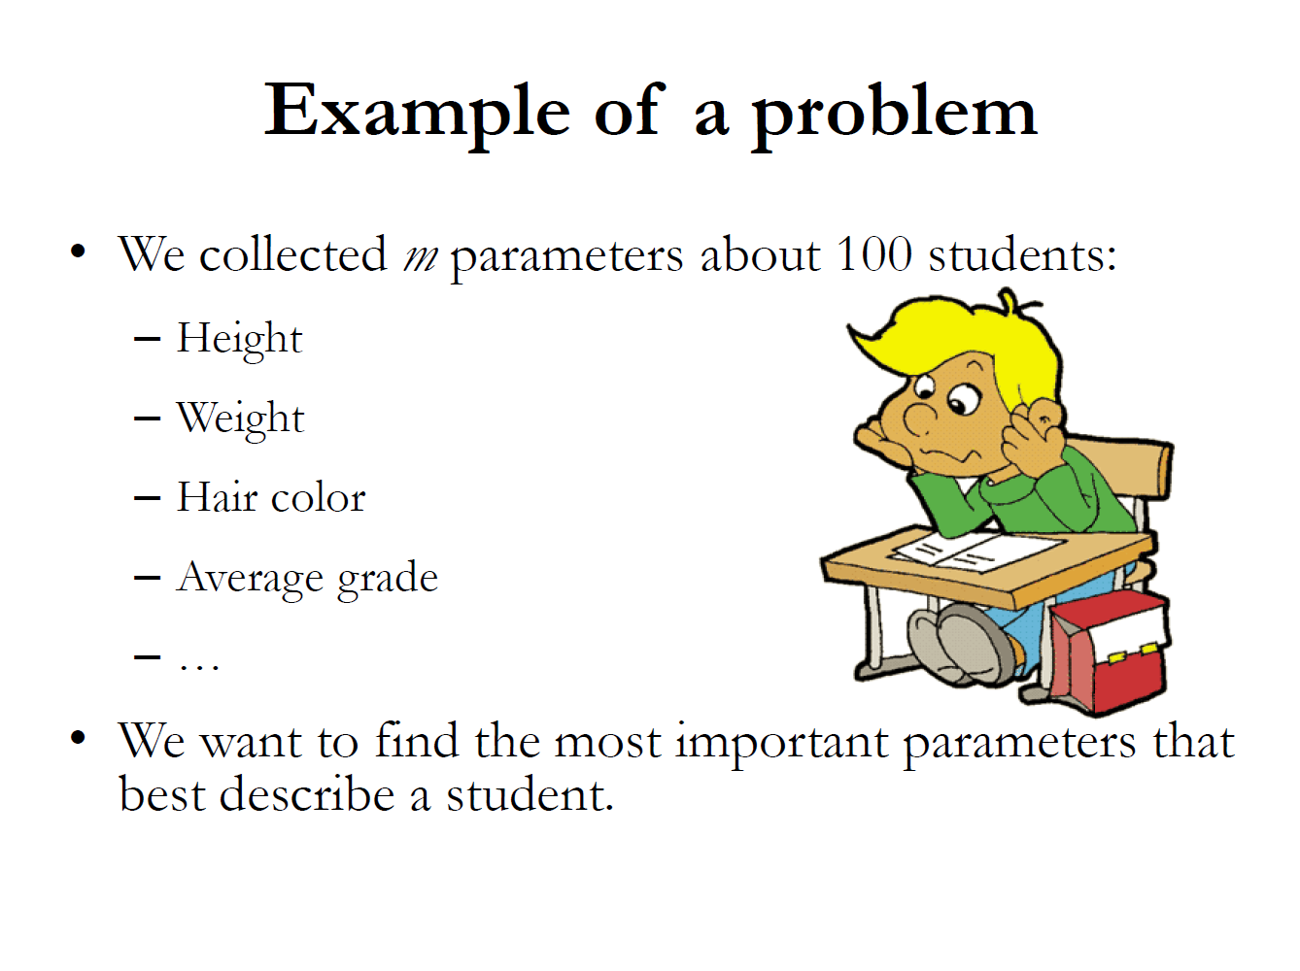

Slide 9
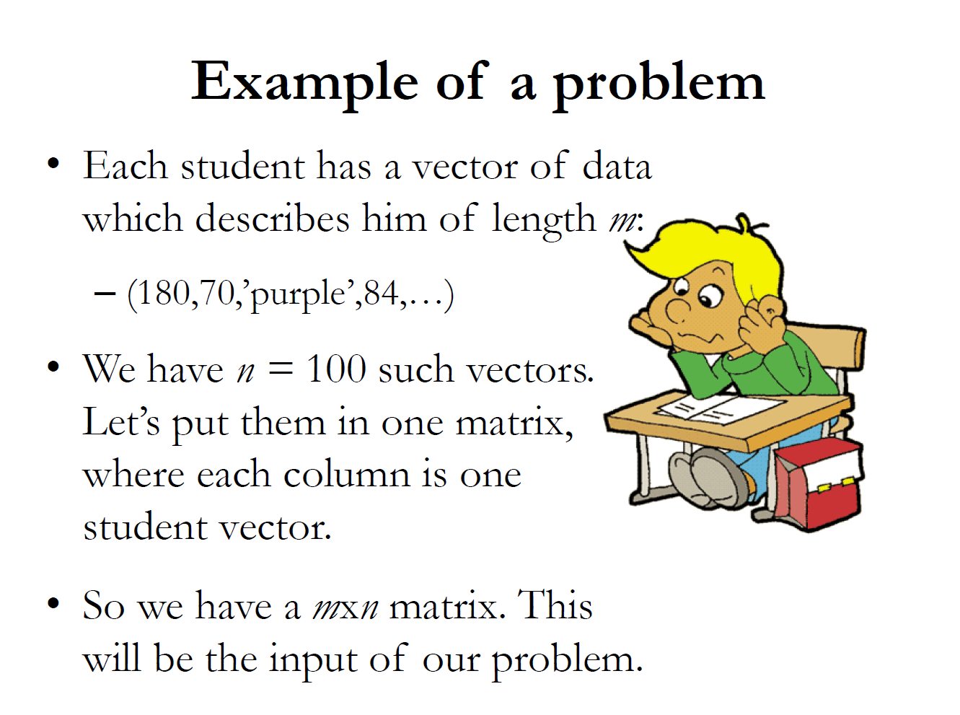

Slide 10
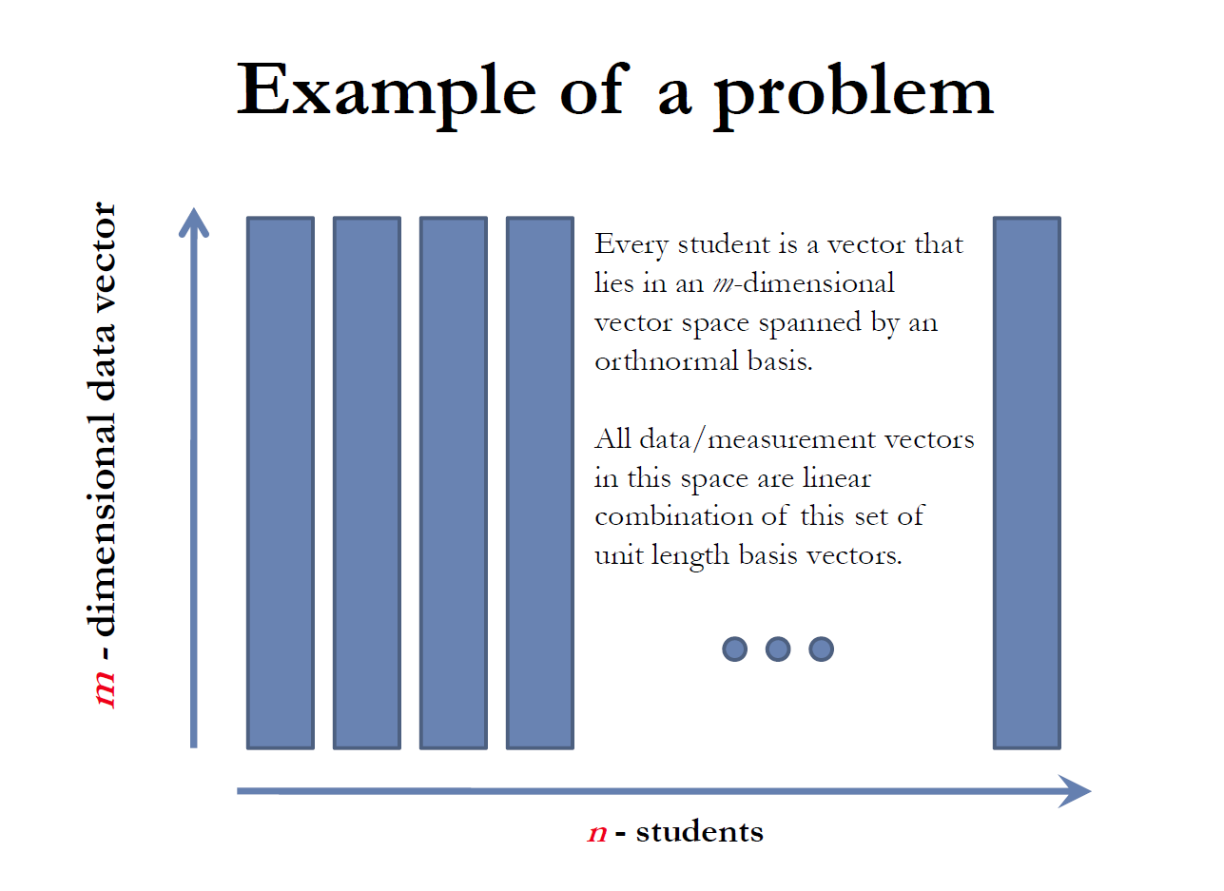

Slide 11
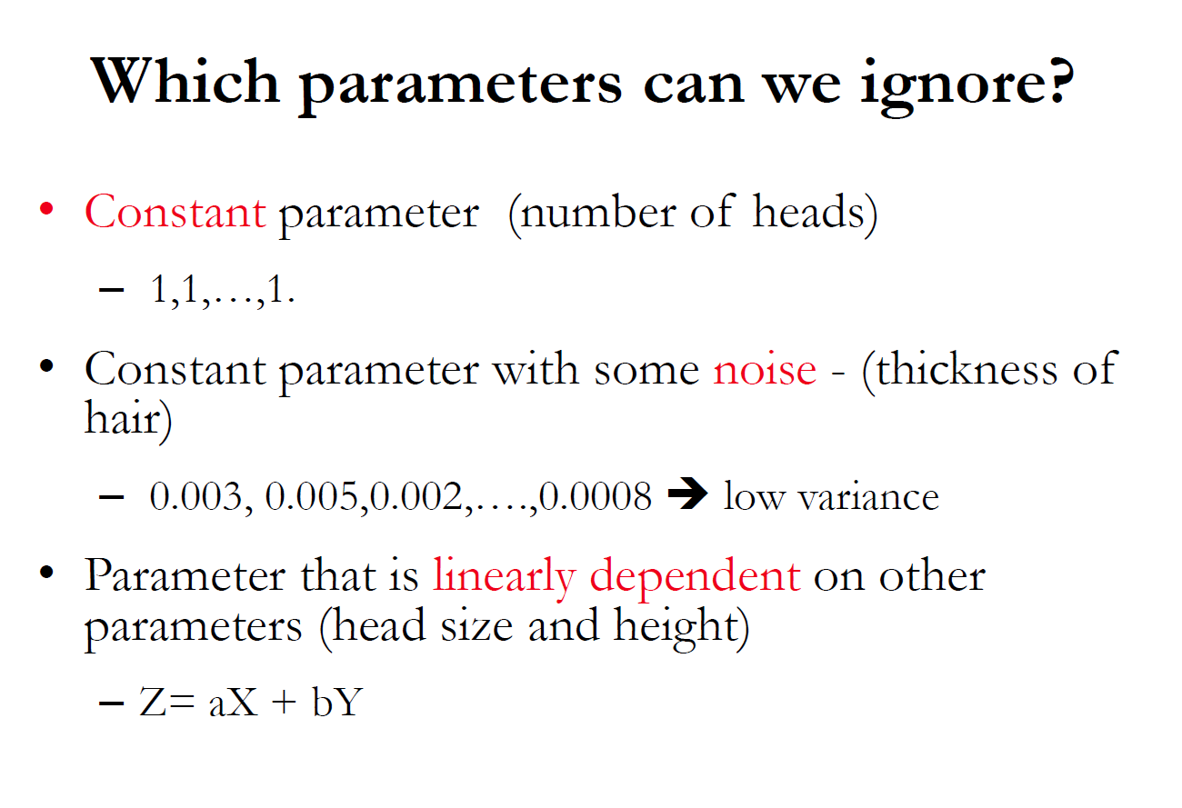

Slide 12
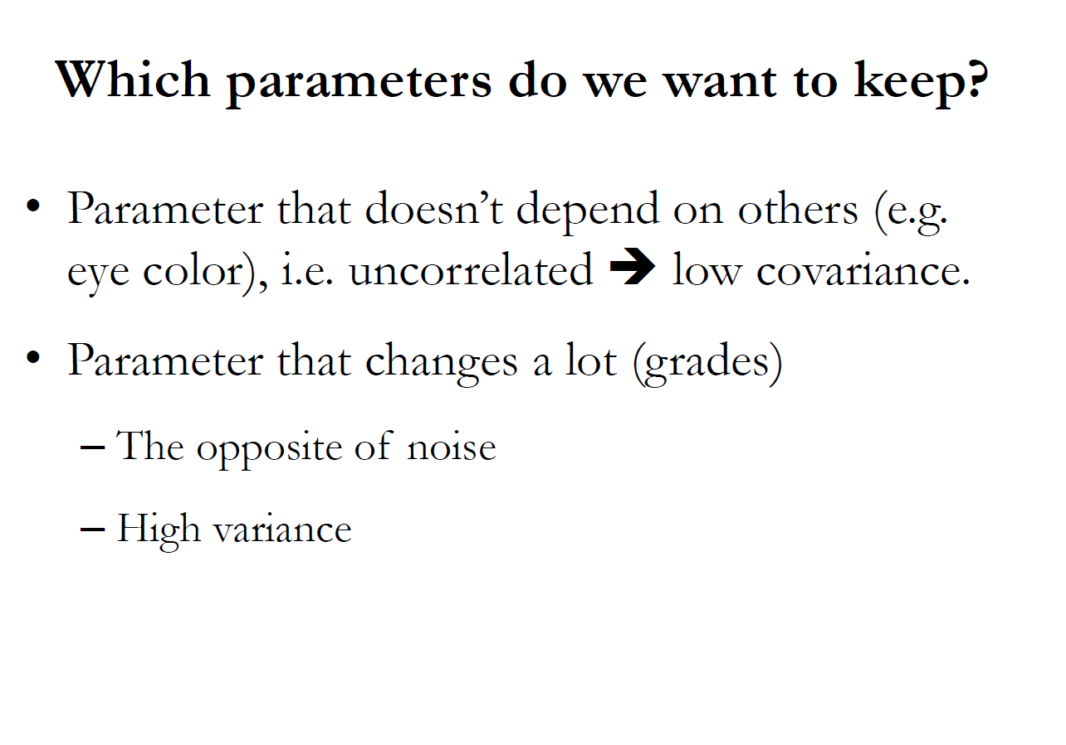

Slide 13
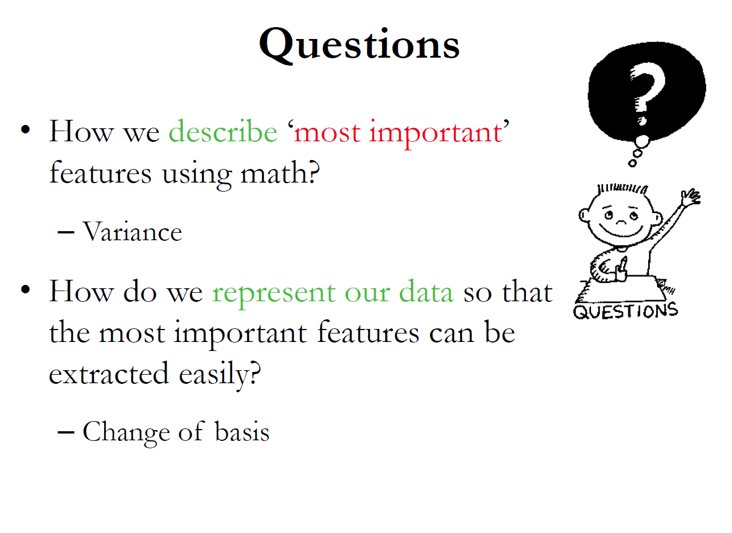

Slide 14
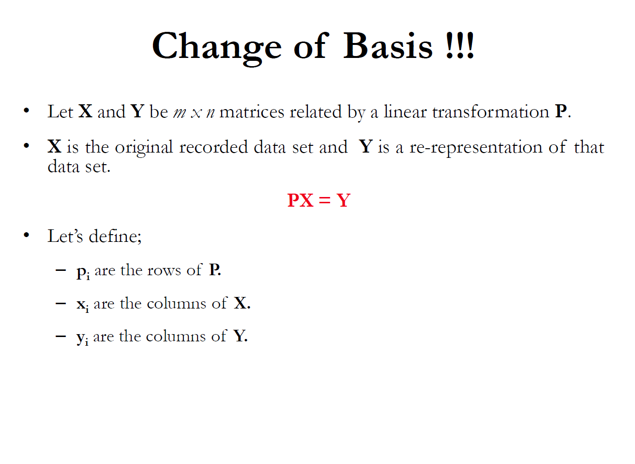

Slide 15
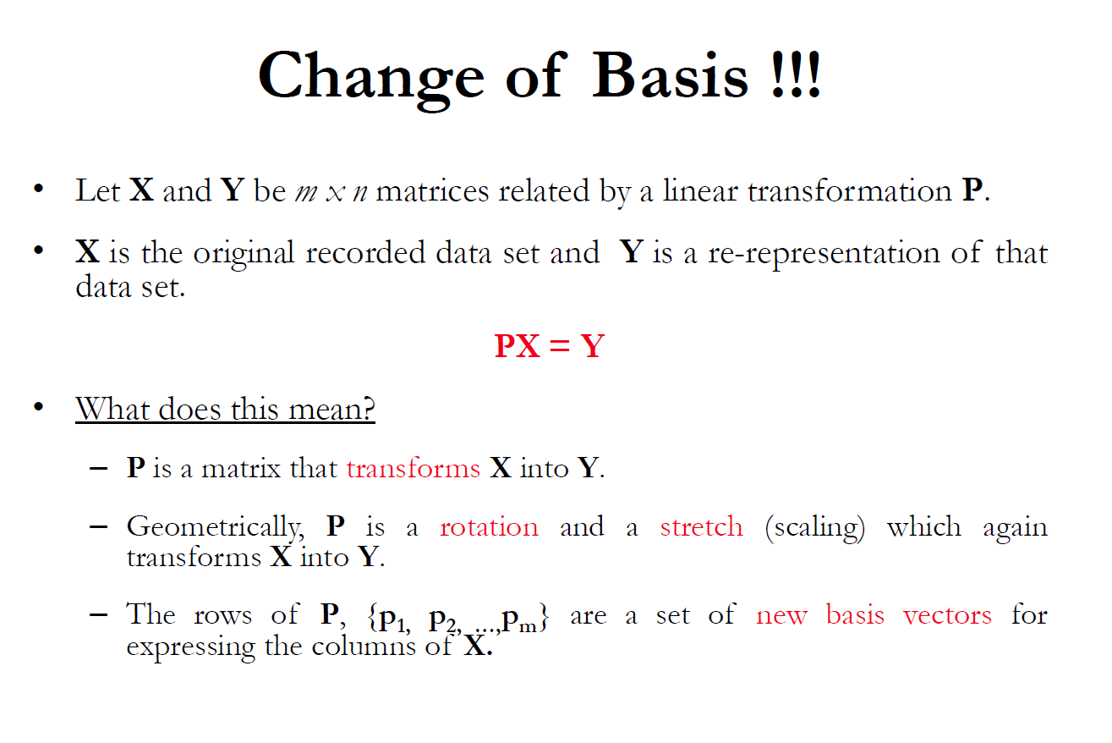

Slide 16
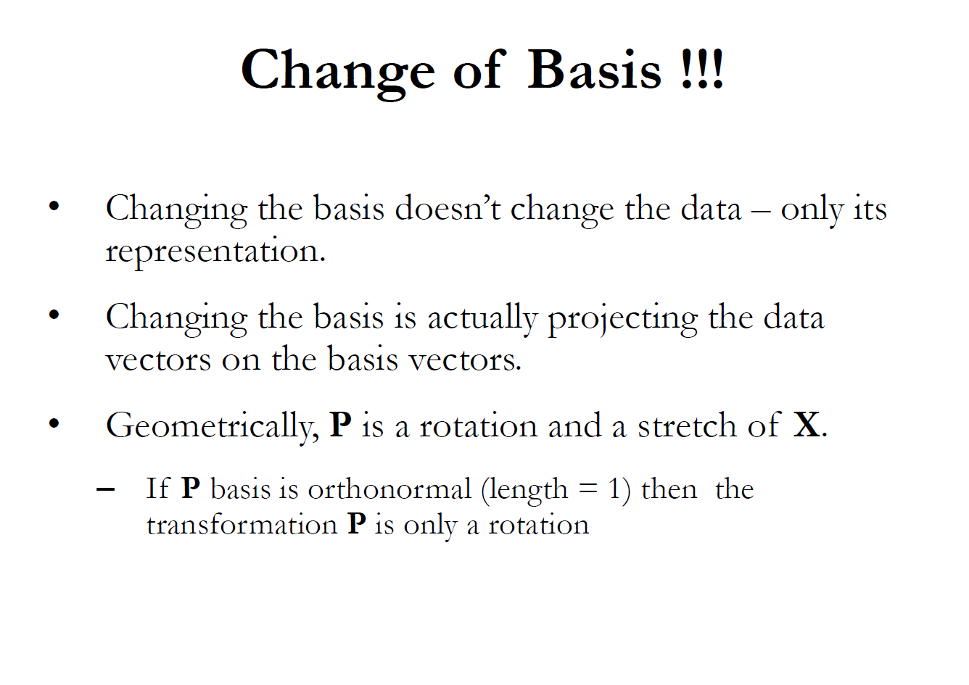

Slide 17
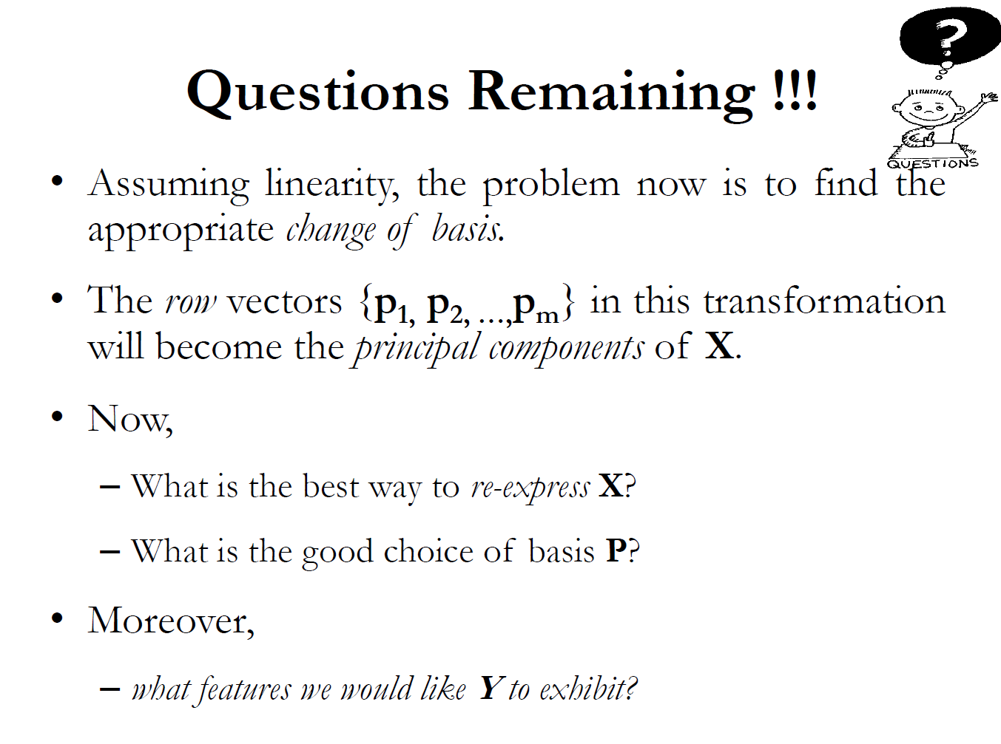
By avoiding mathematics, we state that the best choice for P is the eigenvectors of the variance-covariance matrix of X

Slide 18
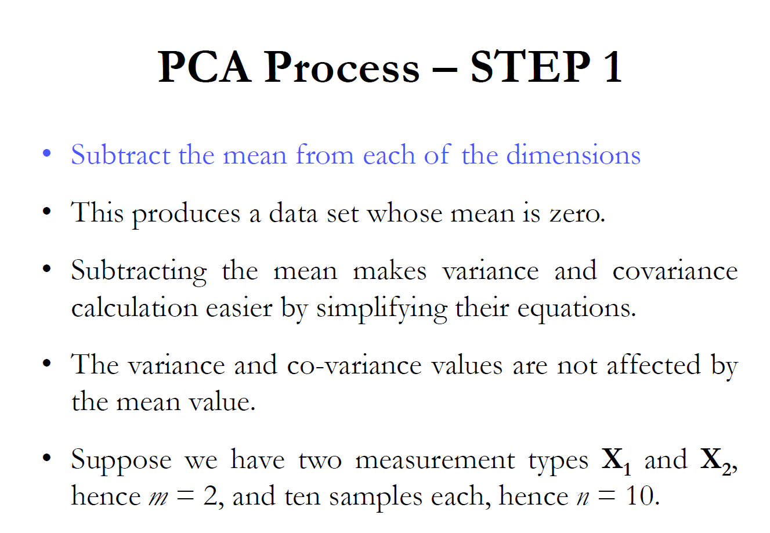

Slide 19
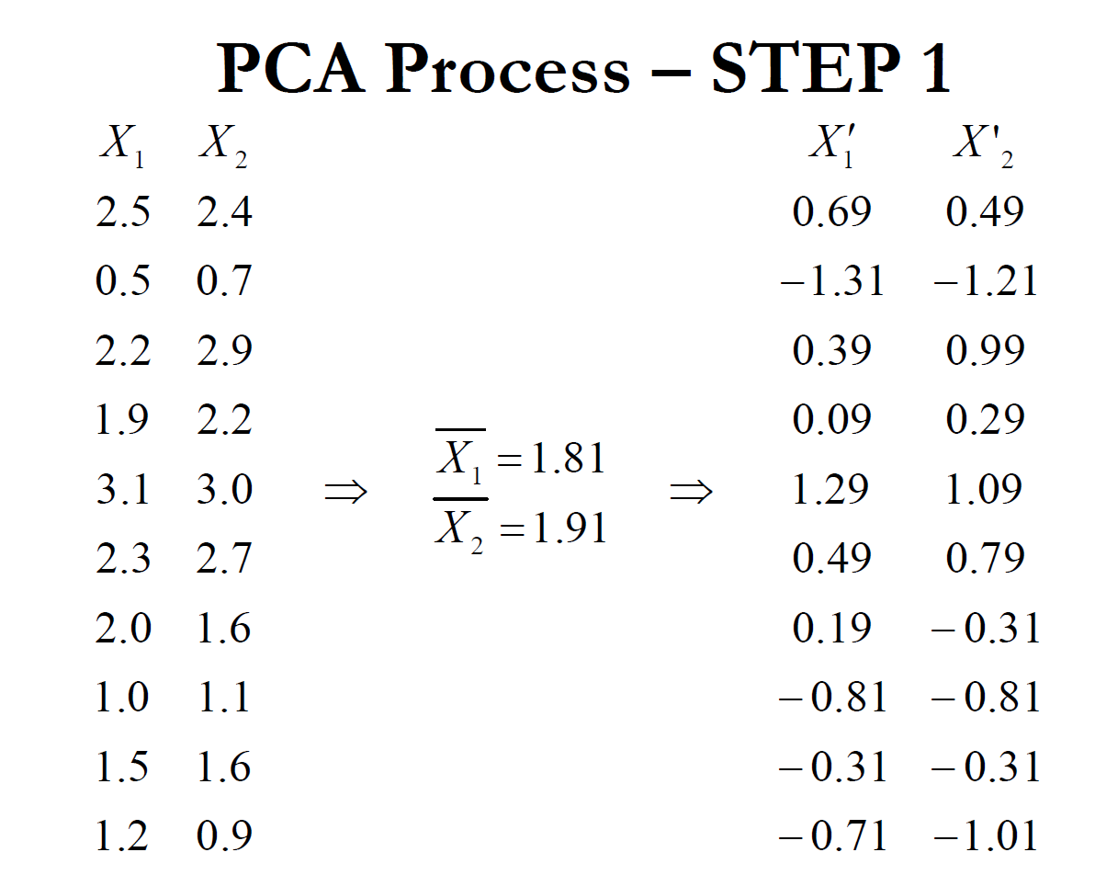

Slide 20
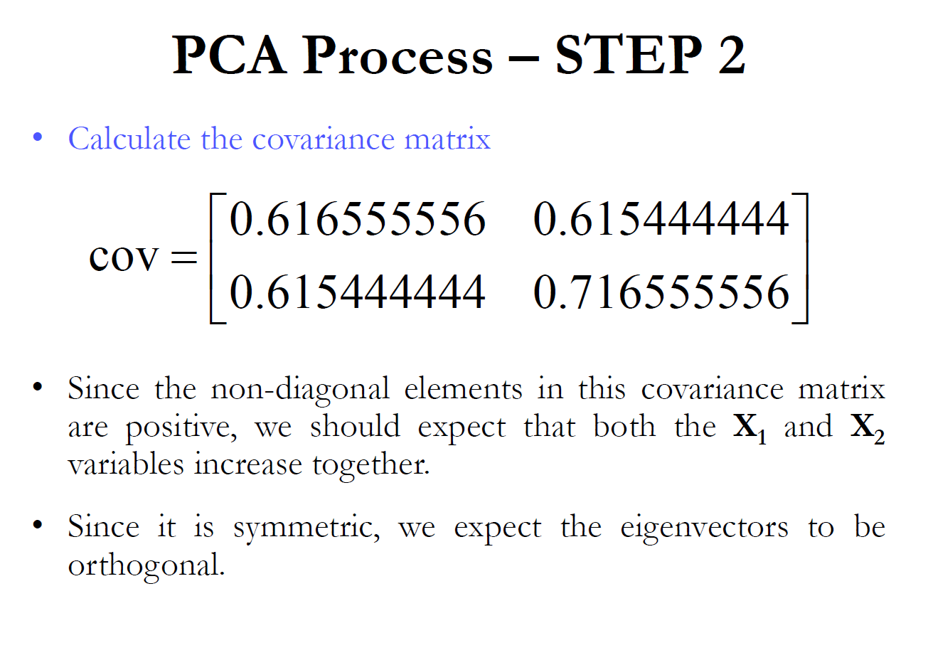

Slide 21
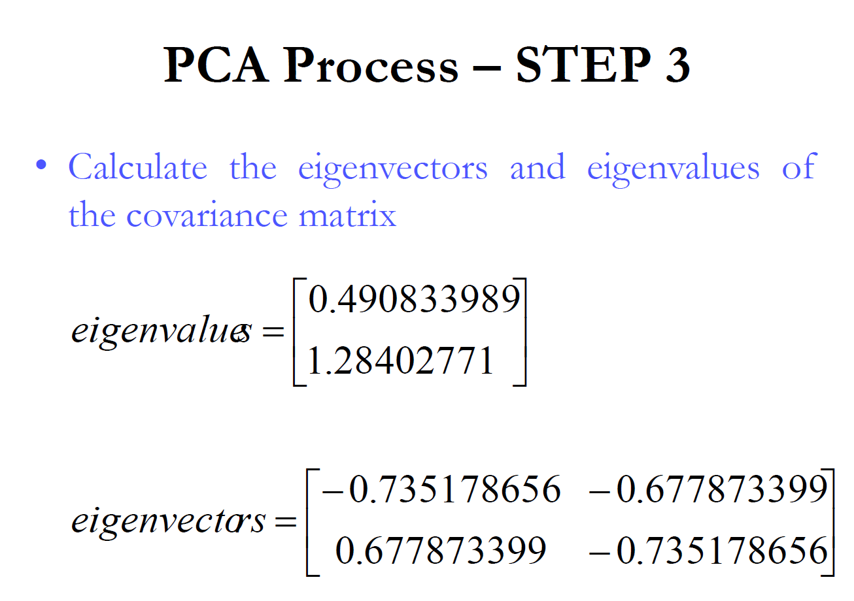

Slide 22
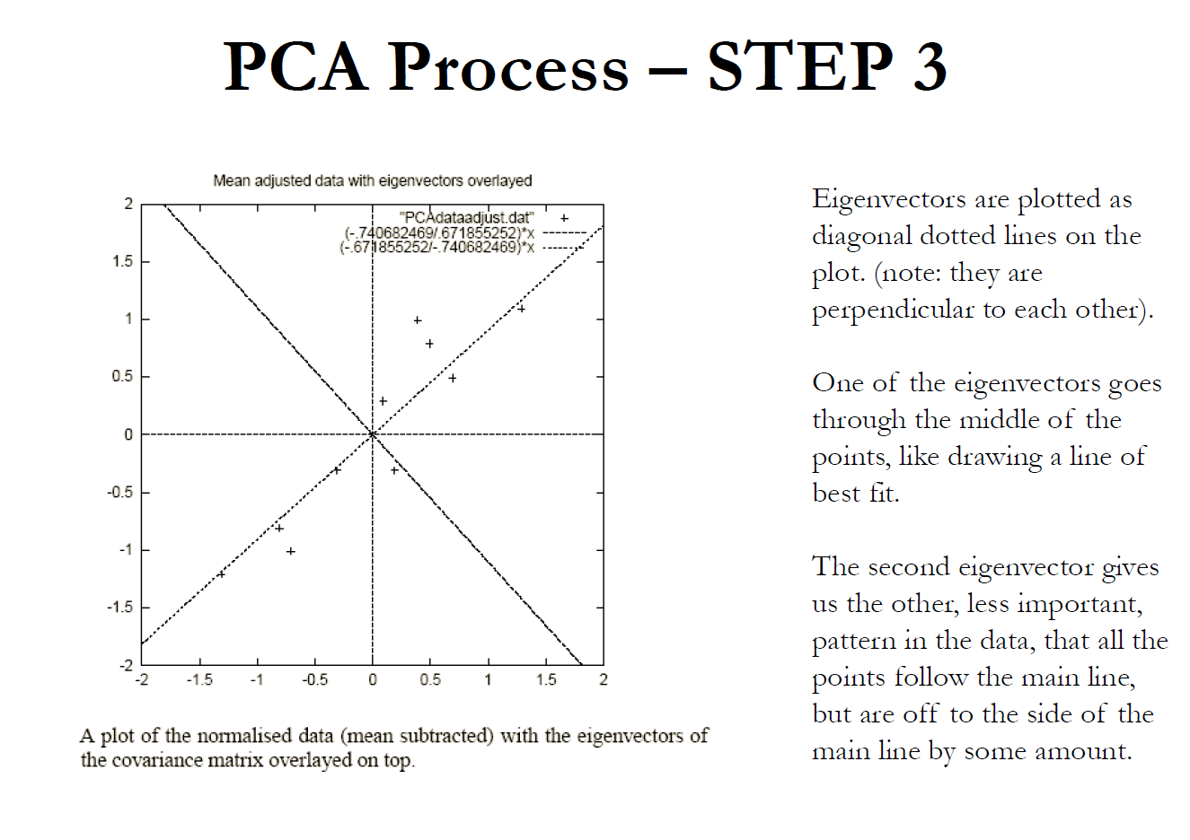

Slide 23
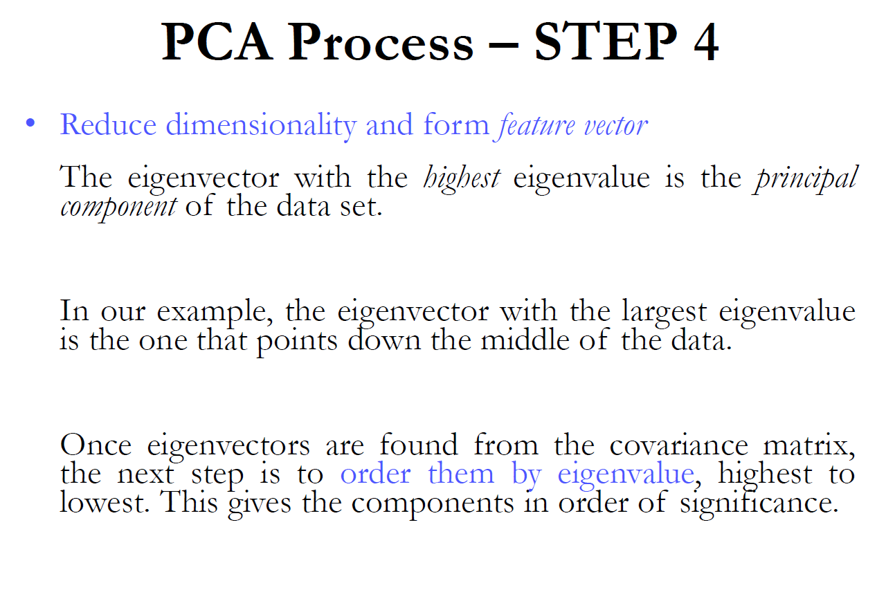

Slide 24
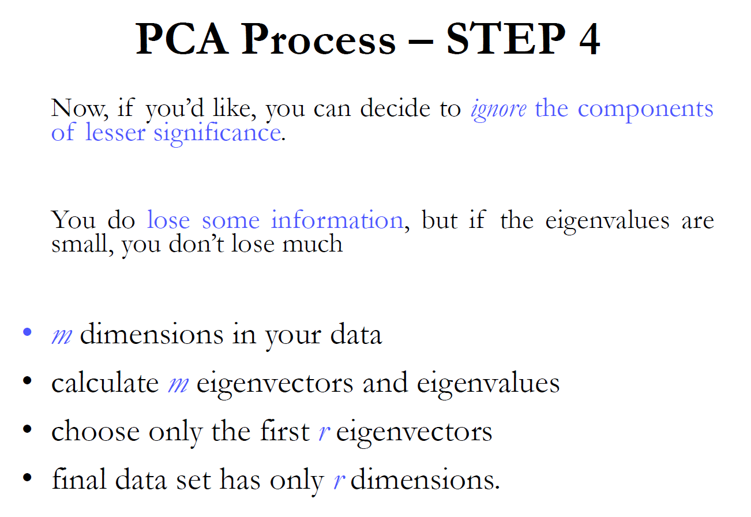

Slide 25
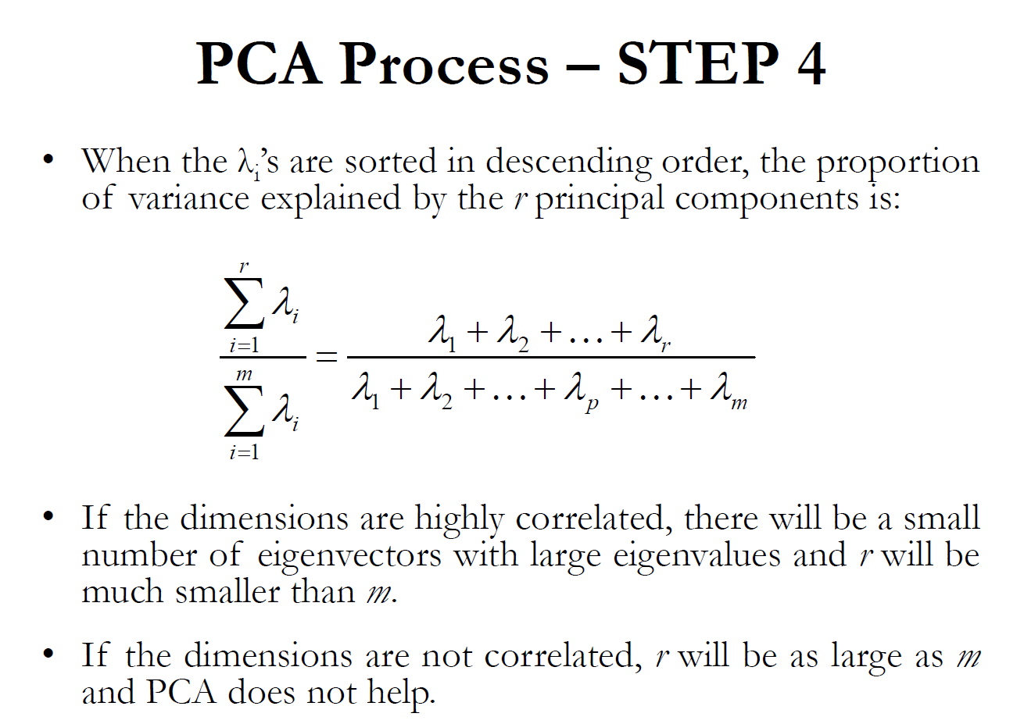

Slide 26
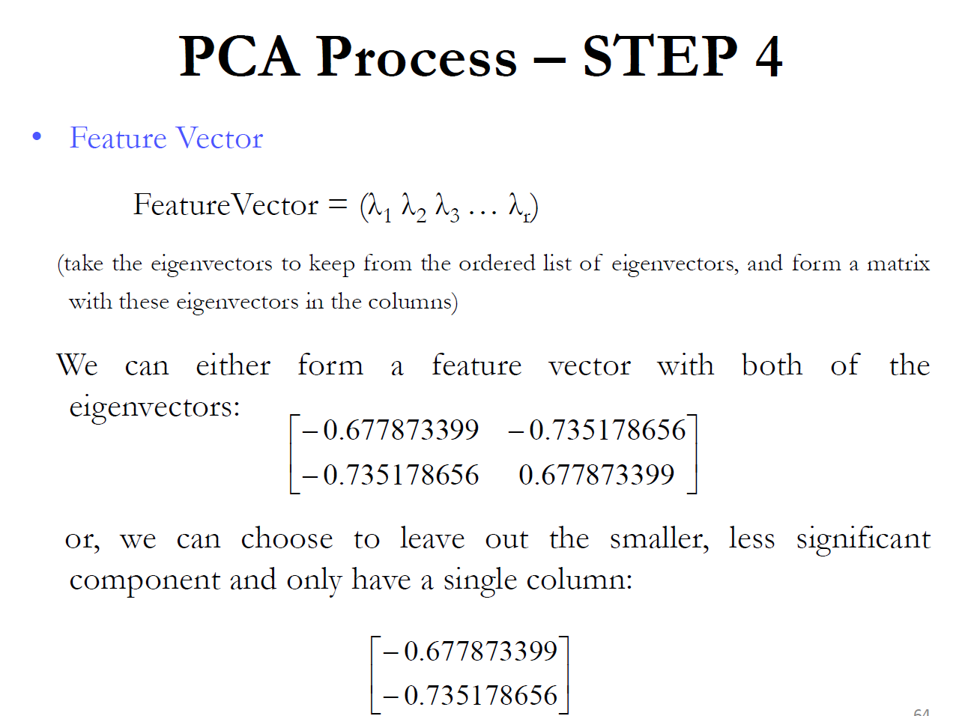

Slide 27
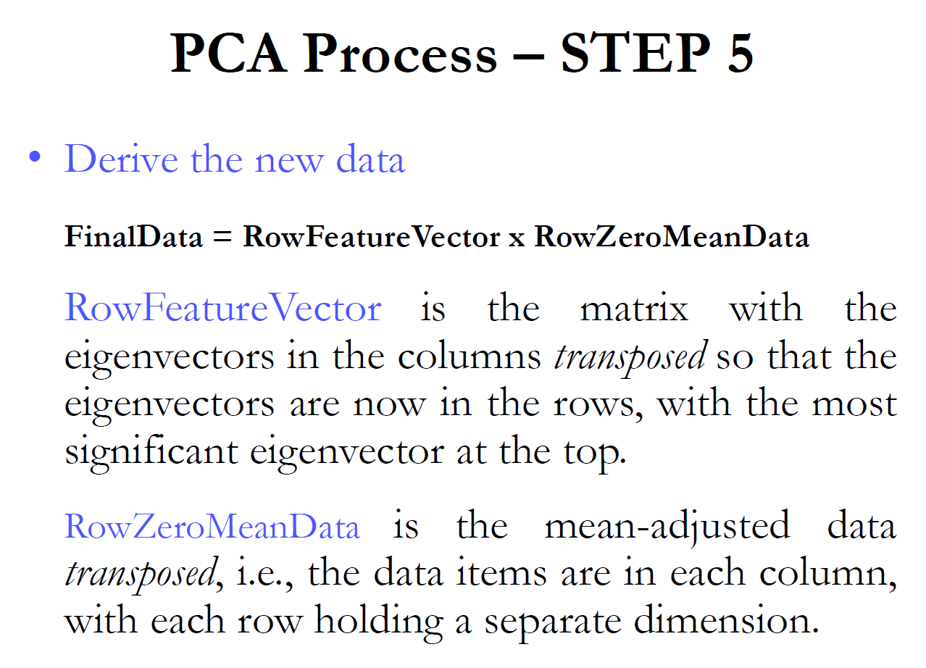

Slide 28
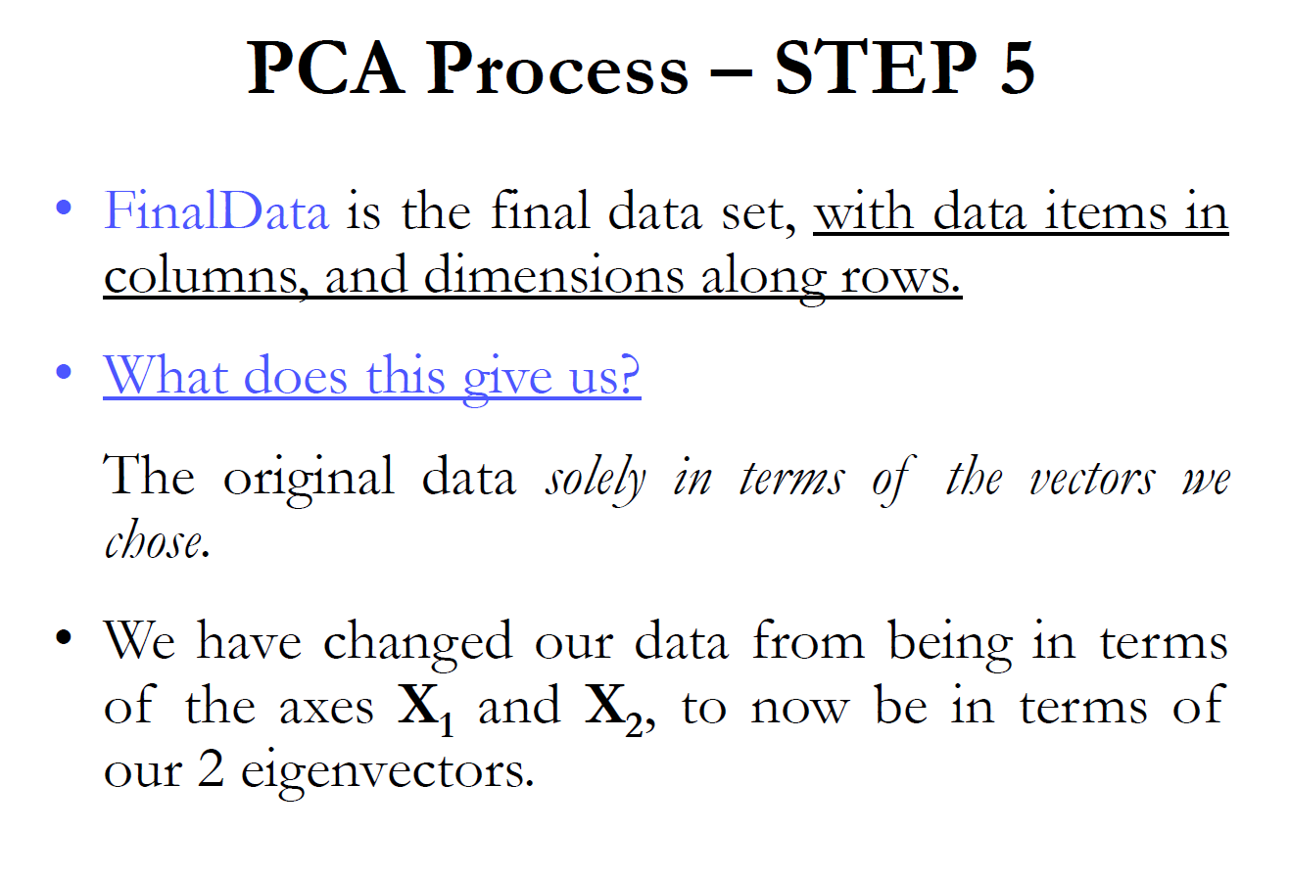

Slide 29
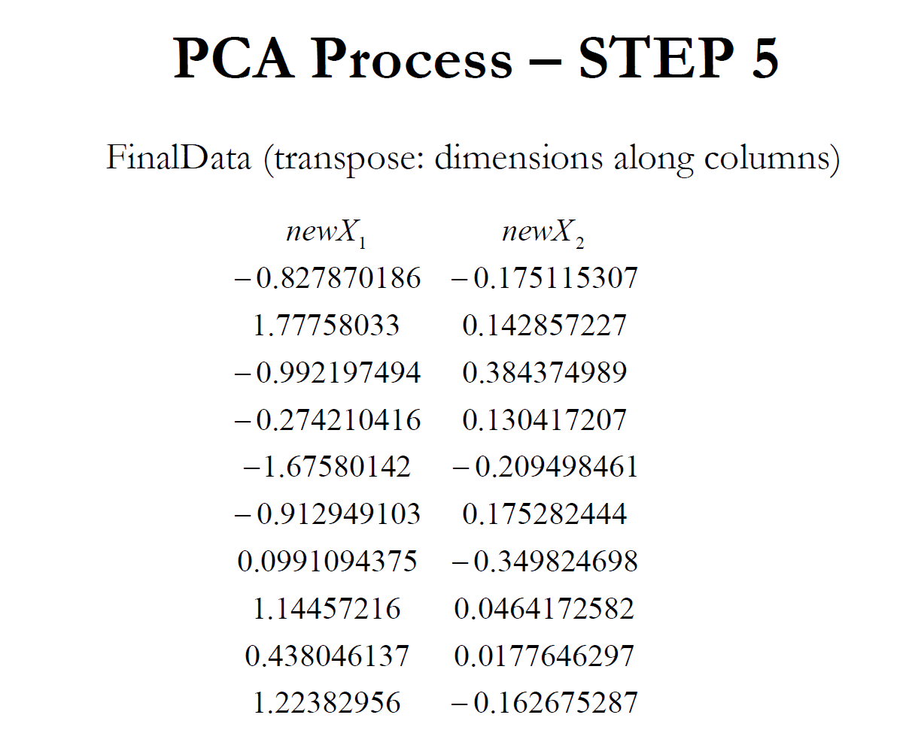
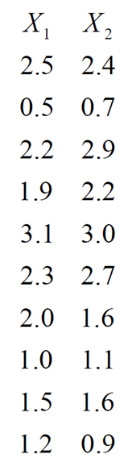
PCA
A
(n x p)
PC
(n x p)
Original Data
A = data matrix
PC = principal component matrix
n = # of observations
p = # of variables

Slide 30
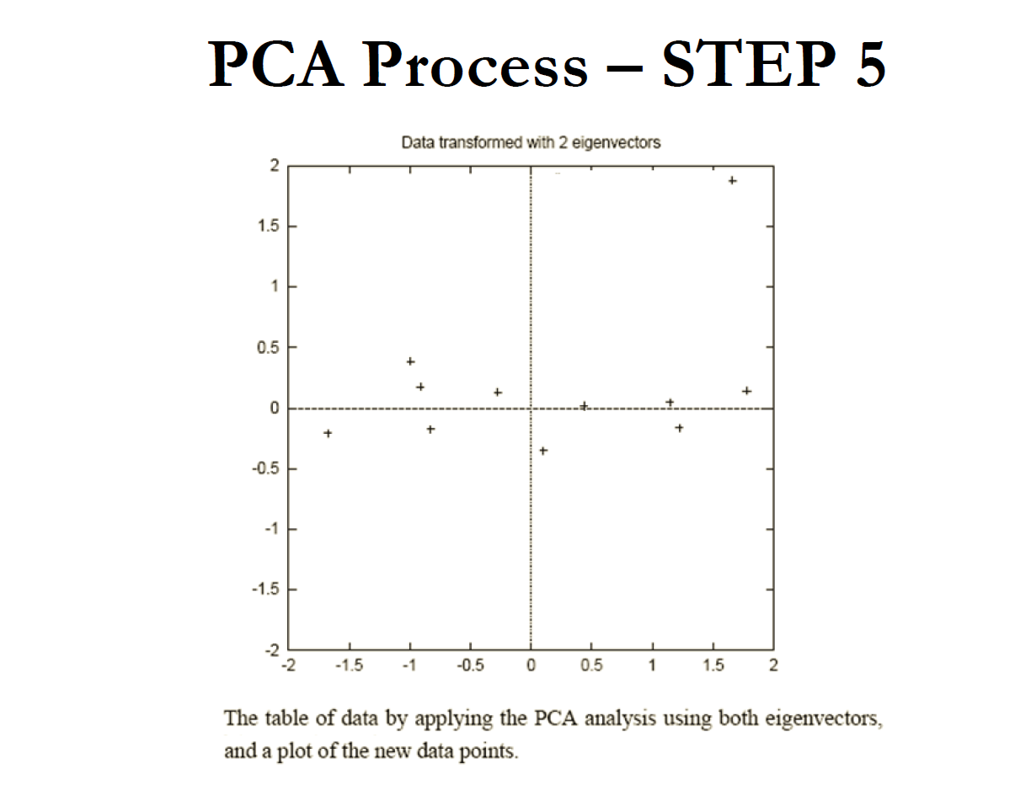

Slide 31
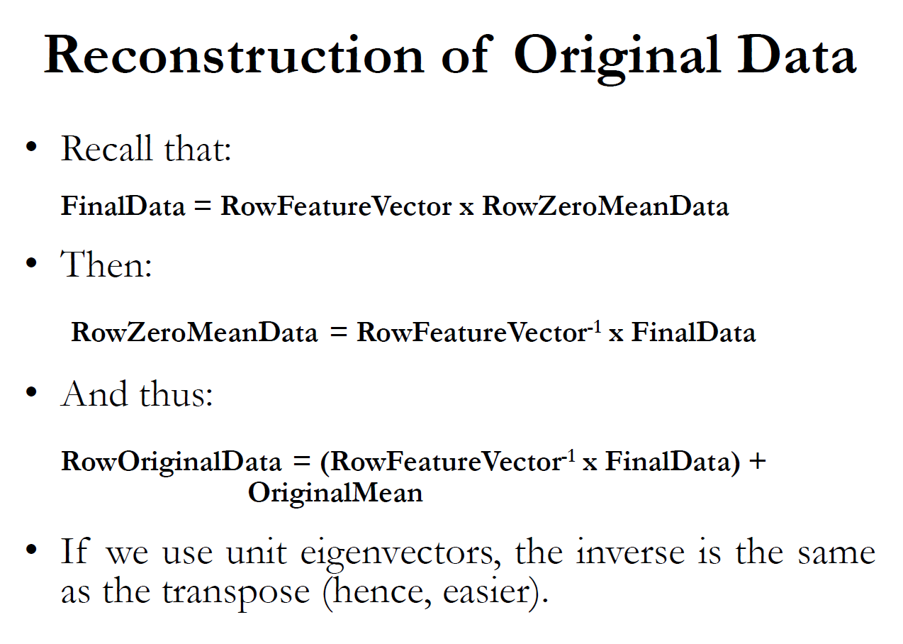

Slide 32
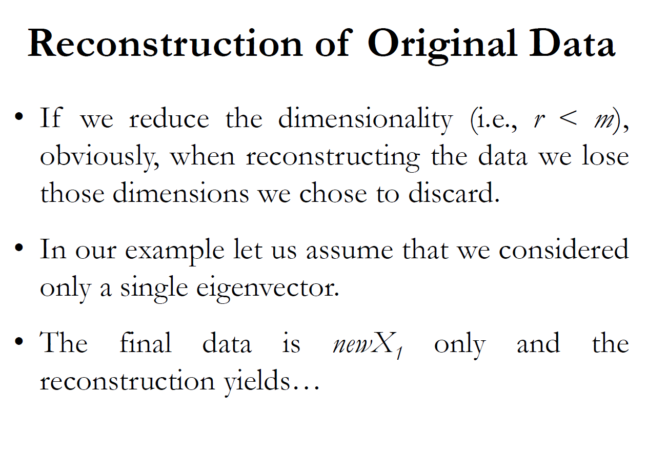

Slide 33
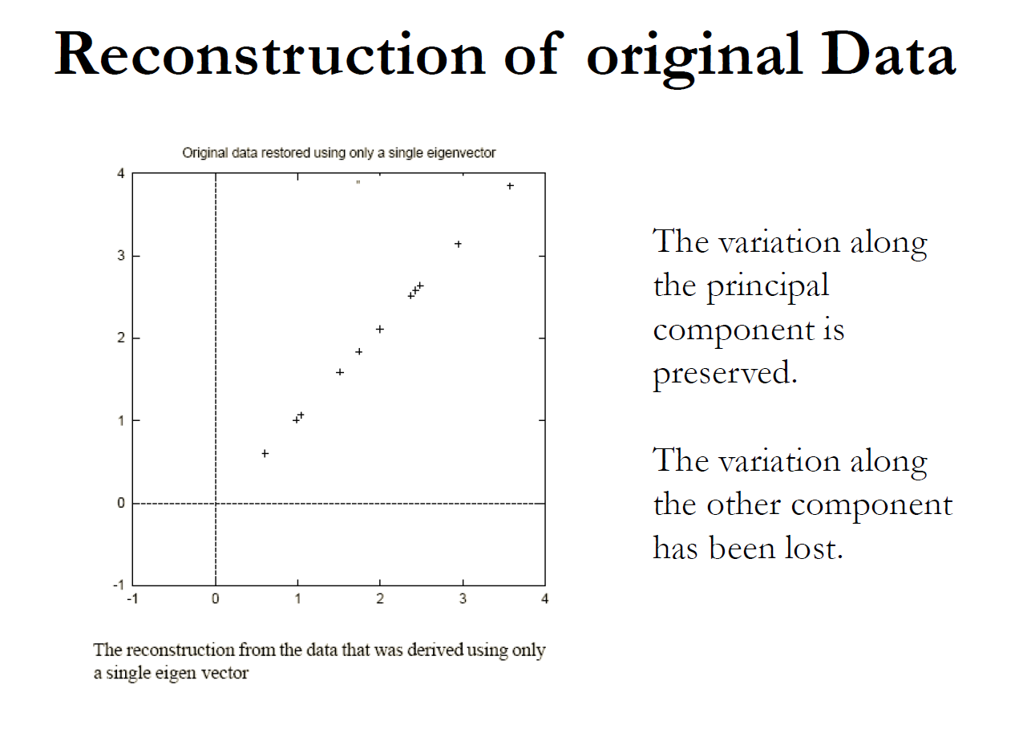

Slide 34
Comments on PCA
In Principal Component Analysis, we look for a few linear combinations of the predictive variables which can be used to summarize the data without loosing too much information.
Intuitively, Principal components analysis is a method of extracting information from a higher dimensional data by projecting it to a lower dimension.

Slide 35
PCA cont.
When data is of up to 3 dimensions, it can be completely visualized
PCA is more useful for visualizing and analyzing 4 or more dimensional data
Let us discuss the steps of PCA using an example of such data as follows:
Student | Math | Chem | Phy | Bio | Eco | Soc
A | 7 | 8 | 7 | 8 | 7 | 7
B | 8 | 7 | 7 | 6 | 8 | 7
C | 9 | 7 | 8 | 7 | 6 | 7
D | 7 | 7 | 7 | 7 | 9 | 8
E | 7 | 6 | 6 | 6 | 8 | 8
F | 7 | 7 | 7 | 7 | 8 | 8
G | 6 | 6 | 6 | 7 | 7 | 7
H | 9 | 8 | 8 | 6 | 6 | 6
I | 8 | 8 | 8 | 7 | 6 | 6
J | 7 | 7 | 6 | 6 | 8 | 9
The steps may appear slightly different from the steps discussed in the previous example but inherently they are the same.

Slide 36
Simple diagram showing steps in PCA
Data Matrix
n ×m
m is the number of variables and n is the number of observations/entities
Zero-mean Data Matrix
n ×m
Make each column zero mean
Resultant Matrix
n ×m
Variance covarience Matrix
m×m
Eigen Vector Matrix
m×m
Zero-mean Data Matrix
n×m
Eigen Vector Matrix
m×m
×
Data example in next slide

Slide 37
Steps in PCA using real data
Zero-mean data
Variance-covarience matrix
Eigenvector Matrix – each column is a vector
Resultant data

Slide 38
Retrieving original data in PCA
Zero-mean Data Matrix
n×m
Eigen Vector Matrix
m×m
Resultant Matrix
n ×m
×
Resultant Matrix
n×m
Transpose of Eigen Vector Matrix
m×m
Zero-mean Data Matrix
n×m
×
If first few columns of resultant matrix is considered filling the rest columns by zero then also we can retrieve original data matrix nxm containing somewhat reduced information.

Slide 39
Retrieving original data in PCA
Original data
Resultant data
Retrieved using all 6 columns of resultant data
[,1] [,2] [,3] [,4] [,5] [,6] A -0.6476044 0.87989769 0.19585228 1.2034647 -0.3381046 -0.2476428 B 0.4071311 -0.11264785 0.12322520 -0.7607375 0.6760256 -0.2670582 C 1.4627792 -0.10506912 1.04938728 0.2756571 -1.3096087 -0.2867973 D -0.4626831 -0.09491780 -0.04951475 0.3244058 1.7096335 0.6867632 E -0.5446152 -1.10607617 -0.94080126 -0.7291790 0.6884824 0.7158256 F -0.3867408 -0.08457518 -0.15028059 0.3740731 0.7292383 0.6598255 G -1.4712402 -1.09608319 -1.03816065 0.3188093 -0.2925755 -0.3102015 H 1.5107622 0.90146570 0.98571998 -0.6929614 -1.2972217 -1.3038175 I 0.6125426 0.91532722 0.85067031 0.3736044 -1.2709467 -1.3399203 J -0.4803314 -0.09732132 -1.02609779 -0.6871364 0.7050775 1.6930233
Retrieved using first 5 columns of resultant data

Slide 40
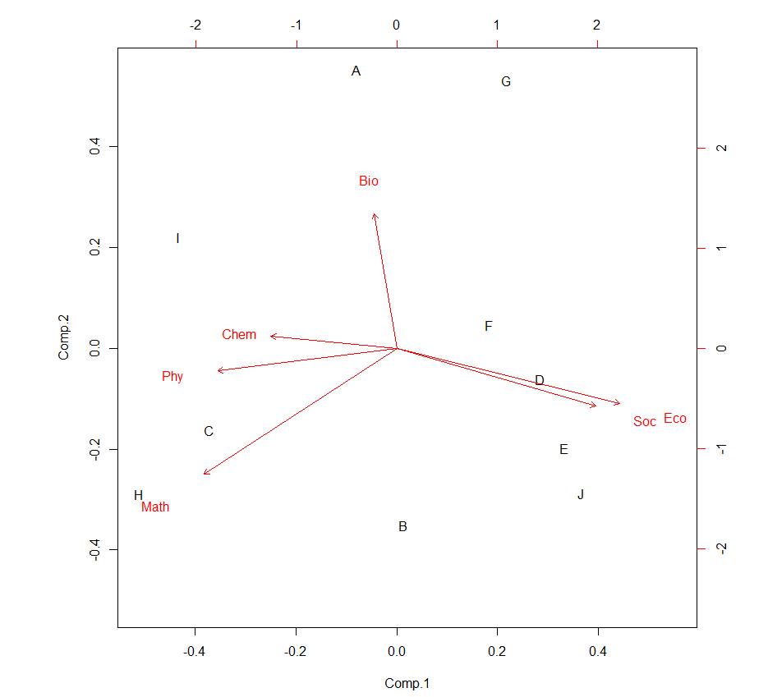
Plot by PCA
Student | Math | Chem | Phy | Bio | Eco | Soc
A | 7 | 8 | 7 | 8 | 7 | 7
B | 8 | 7 | 7 | 6 | 8 | 7
C | 9 | 7 | 8 | 7 | 6 | 7
D | 7 | 7 | 7 | 7 | 9 | 8
E | 7 | 6 | 6 | 6 | 8 | 8
F | 7 | 7 | 7 | 7 | 8 | 8
G | 6 | 6 | 6 | 7 | 7 | 7
H | 9 | 8 | 8 | 6 | 6 | 6
I | 8 | 8 | 8 | 7 | 6 | 6
J | 7 | 7 | 6 | 6 | 8 | 9

Slide 41
Comments related to PCA
Each data point is a vector in a multidimensional space and hence has a direction
The eigenvector corresponding to the largest eigenvalue is also a vector and has a direction
When we take a dot product of a unit vector with another vector, it gives the projection of the vector in the direction of the unit vector (consider B as a unit vector)
When we take the dot product of a data entity with the eigenvector corresponding to the largest eigenvalue, it gives the projection of the data along the direction of the eigenvector.

Slide 42
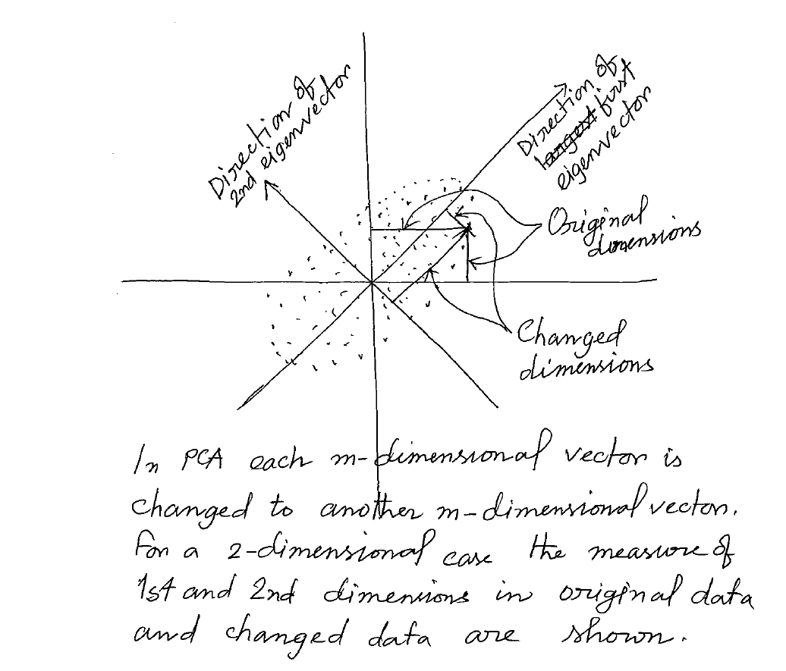
Simple understanding of PCA

Slide 43
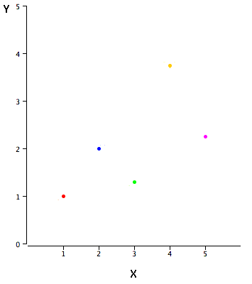
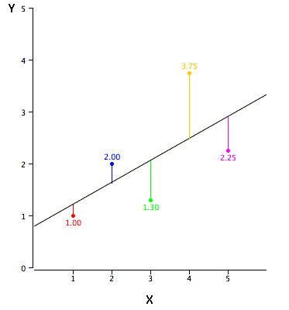
Simple Regression
X | Y
1.00 | 1.00
2.00 | 2.00
3.00 | 1.30
4.00 | 3.75
5.00 | 2.25
example data.
A scatter plot of the example data.
The black line is a tentative prediction line, the points are the actual data, and the vertical lines between the points and the black line represent errors of prediction.

Slide 44
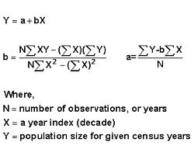
Simple Regression
X | Y | Y' | Y-Y' | (Y-Y')²
1.00 | 1.00 | 1.210 | -0.210 | 0.044
2.00 | 2.00 | 1.635 | 0.365 | 0.133
3.00 | 1.30 | 2.060 | -0.760 | 0.578
4.00 | 3.75 | 2.485 | 1.265 | 1.600
5.00 | 2.25 | 2.910 | -0.660 | 0.436
Linear regression finds a prediction line that minimizes the sum of square of the errors[(Y-Y')²]
The black line is a tentative prediction line, the points are the actual data, and the vertical lines between the points and the black line represent errors of prediction.
In this case the least square prediction line is as follows
Y' = 0.425X + 0.785

Slide 45
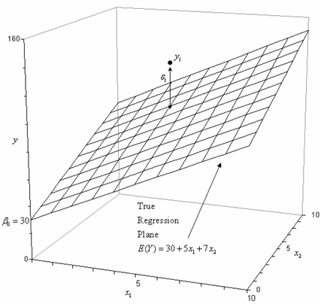
Simple Regression
In case of 3D, it is a prediction plane
In higher dimensions it is called hyperplane---we cannot visualize.
An example of regression plane

Slide 46
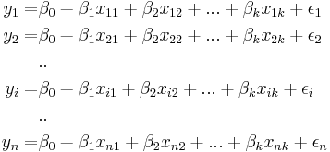
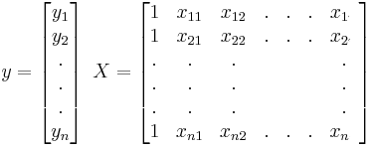
Generalization of the Regression model
A multiple linear regression model for a single response with k predictor variables:
With n independent observation on Y the complete model is as follows:
With n independent observations on Y the complete model is as follows:
y: n×1
X: n×(k+1)
β: (k+1) ×1
ε: n×1
Where
k
k
k

Slide 47
Multiple Regression
Note that we are dealing with vectors and matrices
X1
X2
Linear
Composite
Outcome
X3
X4
Principal Components Regression
Here T refers to our components, W and Q are coefficient vectors as B is above
X1
LinComp
X2
LinComp
New
Composite
LinComp
Outcome
X3
X4
LinComp

Slide 48
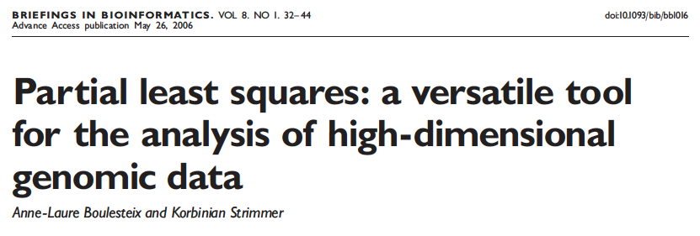
Partial Least Squares (PLS)

Slide 49
Partial Least Squares
Partial Least Squares is just like PC Regression except in how the component scores are computed
PC regression = weights are calculated from the covariance matrix of the predictors
PLS = weights reflect the covariance structure between predictors and response
While conceptually not too much of a stretch, it requires a more complicated iterative algorithm
Nonlinear Iterative Partial Least Squares (NIPALS) and Statistically Inspired Modification of PLS (SIMPLS) algorithms probably most common
Like in regression, the goal is to maximize the correlation between the response(s) and component scores
typically used for data with many more variables (p, genes and features) than observations (n, gene chips and time points)

Slide 50
PLS History
H. Wold (1966, 1975)
S. Wold and H. Martens (1983)
Stone and Brooks (1990)
Frank and Friedman (1991, 1993)
Hinkle and Rayens (1994)

Slide 51
Latent Variable Model
Predictor₁
γ₁
Predictor₂
Response₁
π
Response₂
Predictor₃
Response₃
Predictor₄
γ₂
Predictor₅
Predictor₆
Predictors
Latent Variables
Responses
Note: PLS can handle multiple response variables

Slide 52
Comparison with Regression
Predictor₁
Predictor₂
Predictor₃
Response₁
Predictor₄
Predictor₅
In a nutshell, PLS is a dimension reduction approach that is coupled with a regression model.
Unlike in similar approaches such as principal component regression, the latent components/variables obtained by PLS are chosen with the response variable of the regression kept in mind

Slide 53
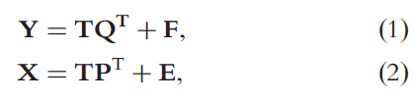
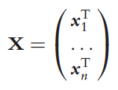
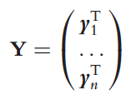
PLS Regression
The available data sample consisting of n observations is denoted as (x_{i},y_{i}) _{i=1 … n}, where x_{i} and y_{i} denote the i-th observation of the predictor and response variables, respectively.
X
Y
PLS regression is based on the basic latent component decomposition:
1
p
1
q
1
1
x_{i}
y_{i}
T: nxc matrix giving the latent components for the n observations,
P (of size pxc) and Q (of size qxc) are matrices of coefficients
E (of size nxp) and F (of size nxq) are matrices of random errors.
n
n x p
n
n x q
Predictors
Responses
x_{i}=(x_{i1}, …, x_{1p})^{T}
y_{i}=(y_{i1}, …, y_{1q})^{T}

Slide 54
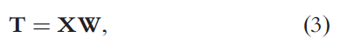
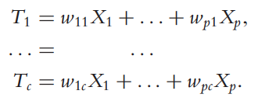
PLS Regression
X
Y
PLS constructs a matrix of latent components T as a linear transformation of X:
1
p
1
q
1
1
W is a pxc matrix of weights.
In the remainder of the explanation, the columns of W and T are denoted as w_{i}=(w_{1i}, . . .,w_{pi})^{T} and t_{i}=(t_{1i}, . . ., t_{ni})^{T},
respectively, for i=1, . . ., c.
For a fixed matrix W, the random variables obtained by forming the
corresponding linear transformations of X₁, . . .,X_{p} are denoted as T₁, . . .,T_{c}:
x_{i}
y_{i}
n
n x p
n
n x q
Predictors
Responses
x_{i}=(x_{i1}, …, x_{1p})^{T}
y_{i}=(y_{i1}, …, y_{1q})^{T}

Slide 55

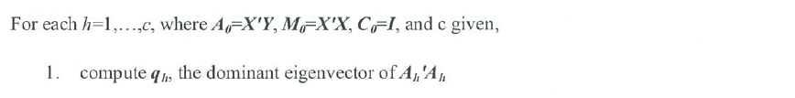
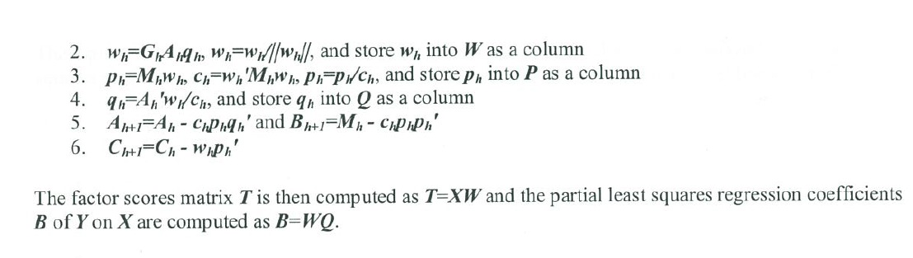

Slide 56
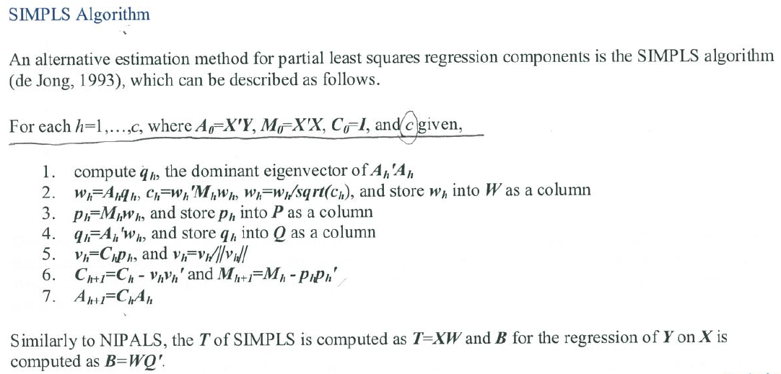

Slide 57
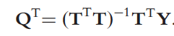
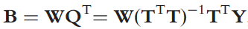
PLS Regression
X
Y
The latent components are then used for prediction in place of the original variables: once T is constructed, Q^{T} is obtained as the least squares
solution of Equation (1):
1
p
1
q
1
1
x_{i}
y_{i}
Finally, the matrix B of regression coefficients for the model Y=XB+F is given as
n
n x p
n
n x q
Predictors
Responses
x_{i}=(x_{i1}, …, x_{1p})^{T}
y_{i}=(y_{i1}, …, y_{1q})^{T}

Slide 58
PLS Benefits and Drawbacks
Benefit
Simultaneous dimension reduction and regression
Drawbacks
Similar to PCA, PLS “chases” co-variability
PLS directions will be drawn to independent variables with the most variability (although this will be tempered by the need to also be related to the response)
Outliers may have significant influence on the directions, resulting scores, and relationship with the response. Specifically, outliers can
make it appear that there is no relationship between the predictors and response when there truly is a relationship, or
make it appear that there is a relationship between the predictors and response when there truly is no relationship

Slide 59
PLS in Practice
PLS seeks to find latent variables/components (LVs) that summarize variability and are highly predictive of the response.
How do we determine the number of LVs to compute?
Evaluate RMSPE (or Q²)
The optimal number of components is the number of components that minimizes RMSPE

Slide 60
Partial Least Squares Disciminant Analysis (PLS-DA)

Slide 61

Notes:
KI080609a

Slide 62
PLS-DA
A supervised method that uses multiple linear regression technique to find the direction of maximum covariance between a data set (X) and the class membership (Y)
X-block contains two-dimensional matrix (I x J), where I is object and J is feature/attribute
Y-block contains two-dimensional matrix (I x K), where K is class
X-block is called as predictors and Y-block is called as response
Partial Least Squares Discriminant Analysis (PLS-DA) is a statistical model for classification and discrimination based on Partial Least Squares Regression (PLSR)
PLS-DA model is a special case of PLSR in which the response variable has the properties of categories or classes
De facto standard for chemometric analysis
Notes:
metabolomics2009_xia

Slide 63


PLS-DA
PLS-DA consists of two steps:
decomposition and regression steps
Decomposition: Both predictors and responses are decomposed into factors such that the factors of predictors have maximum covariance with the corresponding factors of responses
X
Y
T is a matrix of the underlying factor of X, obtained by maximazing its covariance with the corresponding matrix of the underlying factors of Y
T = XW (Eq.1)
where W is a matrix of weight, C is the number of factors extracted.
X
Y

Slide 64
PLS-DA
PLS-DA consists of two steps:
decomposition and regression steps
Regression: statistical process for estimating relationship between variables
T thus is a good predictor of Y and replaced the original predictors X during the regression step
Y = TQ^{t} + D (Eq.2)
where Q is as matrix regression coefficients in term of T as the predictor. The Y-residual express the deviation between the observed and the predicted responses
Subtituting Eq.1 into Eq.2 to obtain the multiple regression model of PLS-DA
Y = XWQ^{t} + D = XB + D (Eq.3)
where the PLS-DA coefficient matrix B, the regression coeffients in term of X as the predictor, is calculated as B = WQ^{t}
X
Y
X
Y

Slide 65
PLS-DA vs. PCA
Partial Least Squares Discriminant Analysis
PLS-DA is a supervised classification technique while PCA is an unsupervised clustering technique
PLS-DA uses “labeled” data while PCA uses no prior knowledge
PLS-DA enhances the separation between groups of observations by rotating PCA components such that a maximum separation among classes is obtained

Slide 66
PLS-DA Validation
PLS-DA results are essentially prediction models or class predictors
These models need to be validated and assessed to make sure they are not over-trained or over-fitted
There are several routes to assessing the quality and robustness of the model – R²/Q² assessments and permutation testing

Slide 67
Validating PLS-DA with Q² & R²
The performance of a PLS-DA model can be quantitatively evaluated in terms of an R² and/or a Q² value
R² is the correlation index and refers to the goodness of fit or the explained variation (range = 0-1)
Q² refers to the predicted variation or quality of prediction (range = 0-1)
Typically Q² and R² track very closely together

Slide 68
PLS-DA R²
R² is a quantitative measure (with a maximum value of 1) that indicates how well the PLS-DA model is able to mathematically reproduce the data in the data set
A poorly fit model will have an R² of 0.2 or 0.3, while a well-fit model will have an R² of 0.7 or 0.8.

Slide 69
PLS-DA Q²
To guard against over-fitting, the value Q² is commonly determined. Q² is usually estimated by cross validation or permutation testing to assess the predictive ability of the model relative to the number of principal components used in the model
Generally a Q² > 0.5 if considered good while a Q² of 0.9 is outstanding

